Slide 1

JSON Objects
JSON objects are surrounded by curly braces {}.
JSON objects are written in key/value pairs.
Keys must be strings, and values must be a valid JSON data type (string, number, object, array, boolean or null).
Keys and values are separated by a colon.
Each key/value pair is separated by a comma.

Slide 2
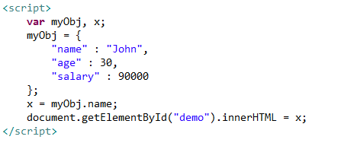
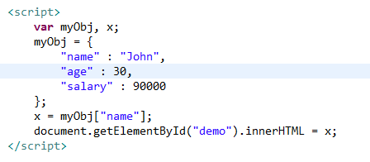
JSON Objects
We can access the object values by using dot (.) notation
We can also access the object values by using bracket ([]) notation

